Slide 1
Causal Inference
A brief tour of common methods used to discern causation from correlation

Slide 2
Ideally…
To assess causality, we’d ideally set up a randomized controlled trial
Entities are randomly sorted into treatment and control groups
The treatment group is subjected to some type of policy, treatment, intervention, drug, etc. while the control group is not (Though the control group may be given some type of placebo)
After enough time has passed for the treatment to take place, the outcomes / changes in each group are measured
The difference in outcomes is the effect of the intervention
Randomization breaks the link between treatment and all other factors

Slide 3
Difference In Differences (DiD)
Causal effects are determined by comparing the changes in outcomes over time between a treatment group and a control group
Assumes that, absent treatment, the differences in the groups would have followed similar trends over time (parallel trends assumption)
DiD = (Post-Treatment Treatment Group Outcome - Pre-Treatment Treatment Group Outcome) - (Post-Treatment Control Group Outcome - Pre-Treatment Control Group Outcome)
Yit = B0 + B1(Period Dummy) + B2(Group Dummy) + B3(Period and Group Interaction) + Eit
B3 is the difference in differences

Slide 4
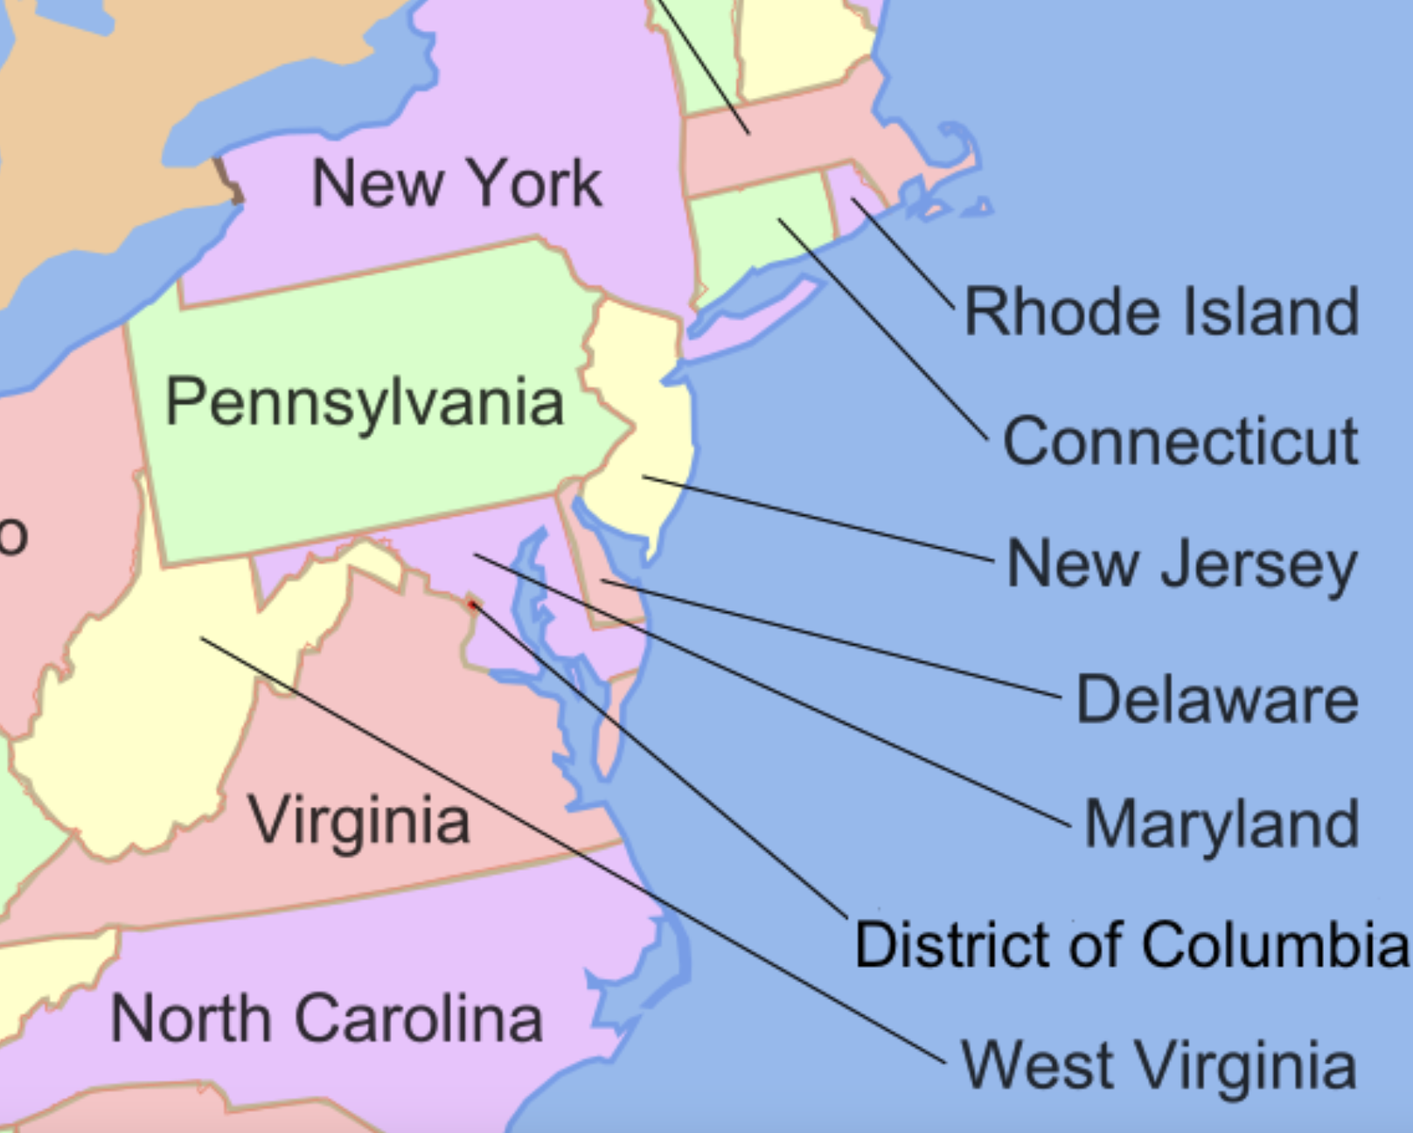
Card & Kruger
New Jersey and Pennsylvania share a border, and thus a fairly similar population
NJ raised the minimum wage from $4.25/hr to $5.05/hr, while PA kept its minimum wage at $4.25/hr
Economic theory suggests that the quantity of labor demanded will fall if the price of labor rises.
However, this is not what was found…

Slide 5
DiD Assumptions
Parallel trends: In the absence of treatment, both groups would have followed the same trend over time
No other simultaneous changes
Stable group composition
No spillover effects

Slide 6
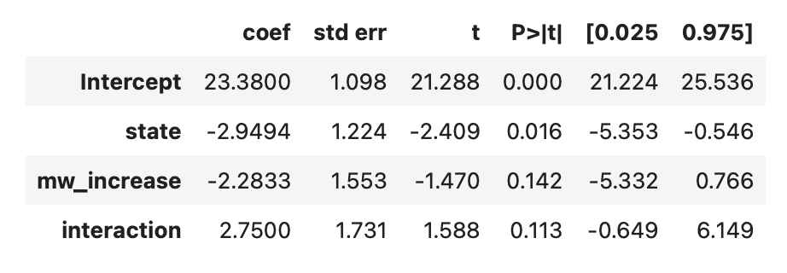
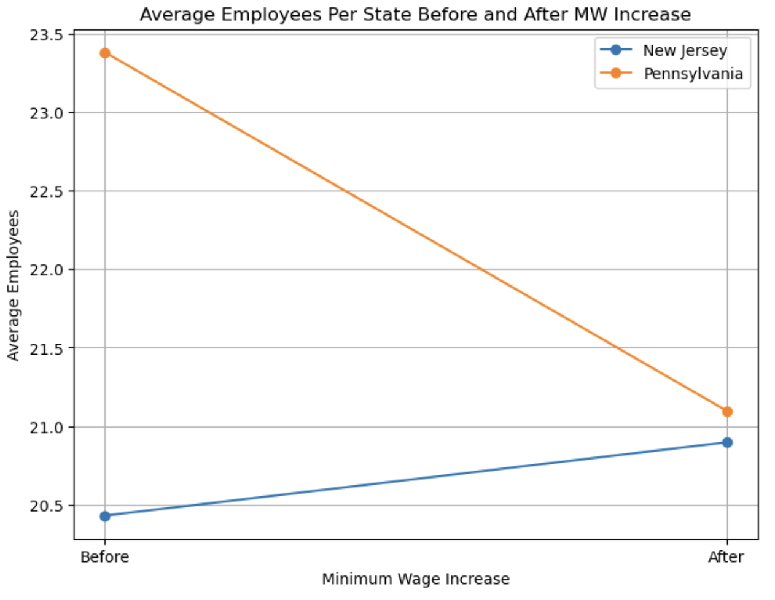
DiD Regression
Employment = B0 +
B1(State Dummy) +
B2(Period Dummy) +
B3(State * Period) +
Bi(Control Variables) + E
B3 = Estimated Treatment Effect = Effect of Minimum Wage Increase on Employment

Slide 7
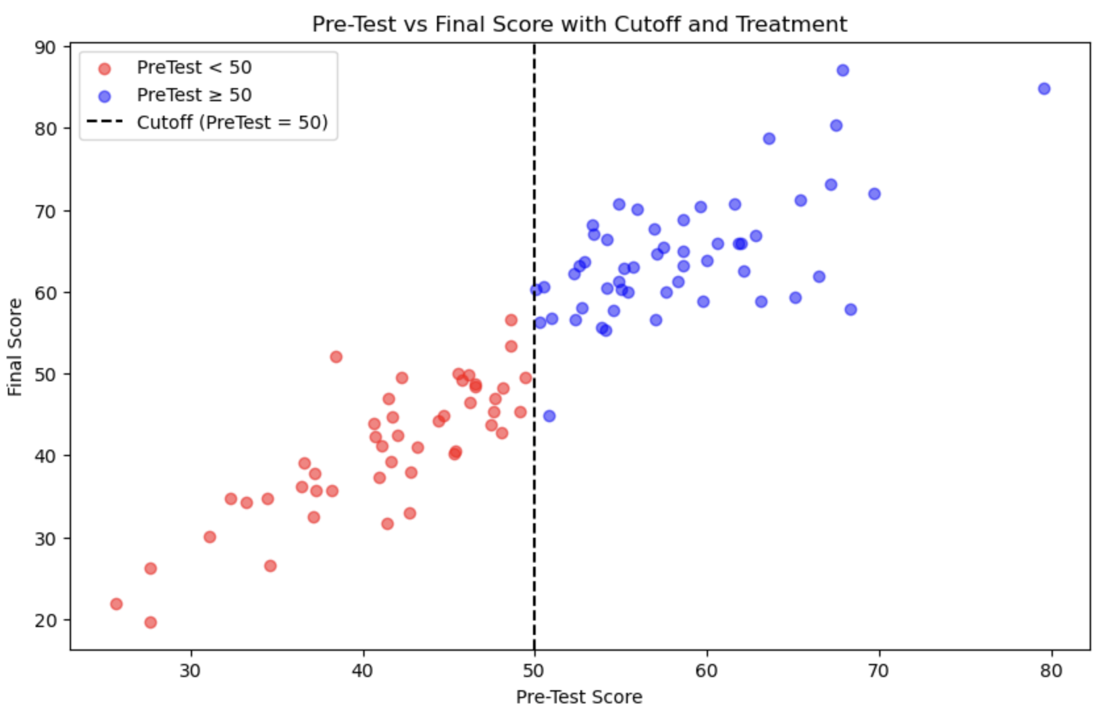
Regression Discontinuity Design
Causal effects are determined by comparing outcomes between treatment and control groups when assignment is determined by a cutoff point / threshold
Assumes groups just above and below the cutoff are likely to be comparable / similar
Consider a group of students who get to take honors classes if they score above 50% on a given test, and are then given a final knowledge assessment

Slide 8
RDD Assumptions
Continuity: Absent treatment effect, there should be no jump at the cutoff
Local Comparability: Units just above and below cutoff should be very similar
No Precise Manipulation of the Running Variable: Individuals cannot precisely sort themselves into above and below
Treatment is determined by cutoff
Note: RDD determines causal effect at cutoff, not for all units

Slide 9
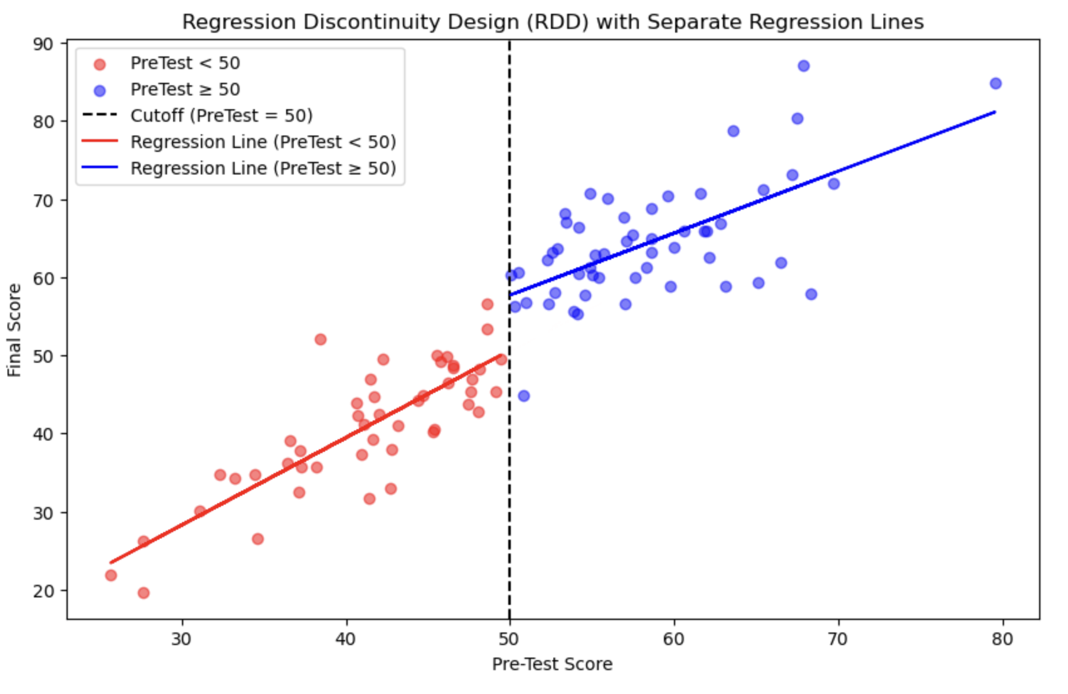
RDD Regression
The causal effect of the treatment (extra education) is measured as the difference in the heights of the regression lines at the cut off
Y =
B0 +
B1*(Treatment Dummy) +
B2*(Running Variable - Cutoff) +
B3*(Treatment Dummy)*(Running Variable - Cutoff) +
E
B0 = Expected outcome just below the cutoff
B1 = Treatment effect at the cutoff (jump)
B2 = Slope of the outcome variable for the control group
B3 = The difference in slopes between the treated and control groups

Slide 10
We would expect the red trend to continue, absent treatment
Gap = Treatment Effect

Slide 11
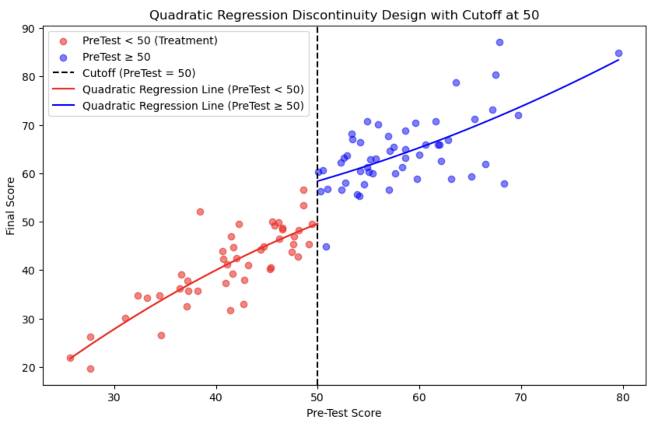
Quadratic RDD

Slide 12
Two Stage Least Squares
Does education cause higher wages, or do smart and ambitious people go to college and are incidentally likely to earn higher wages regardless of education?
Wage = B0 + B1(Education) + E
Omitted variable bias likely since no controls for ability, upbringing, etc.
Use an instrumental variable:
A) One that is strongly correlated with endogenous variable (education)
B) Not correlated with the error term in the outcome equation

Slide 13
Two Stage Least Squares (2SLS)
Endogeneity: Explanatory variable is correlated with error term
Causes of Endogeneity:
Omitted variable bias
Simultaneity (X effects Y and Y effects X)
Measurement error
Instrumental Variable: Correlated with X but not correlated with E

Slide 14
Two Stage Least Squares (2SLS)
Consider the case of education’s impact on income.
To what extent does education make workers more skilled and/or productive?
Might it be that ambitious, productive, intelligent, and/or skilled individuals also pursue higher education, but would be skilled and productive even without it?
Solution: Find a variable that is correlated with education, but not with unobserved factors influencing income
Proximity to universities? Likely to increase chances for education without directly impacting wages through a non-educational channel
Card, David (1995). “Using Geographic Variation in College Proximity to Estimate the Return to Schooling.”

Slide 15
2SLS Continued
Step 1: Regress the endogenous variable on the instrument and obtain fitted values (y-hat OR education-hat)
Education = B0 + B1*Proximity to College + E
Step 2: Regress the original dependent variable on the fitted values from the first equation.
Wage = B0 + B1*Education-Hat + E
The fitted values isolate the variation in education explained by the instrument
Education hat is no longer correlated with ability and upbringing, so now B1 reflects the causal effect of education on wages

Slide 16
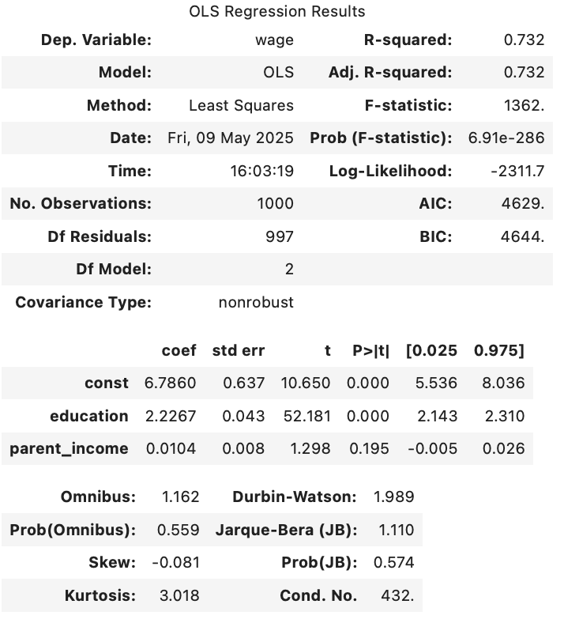
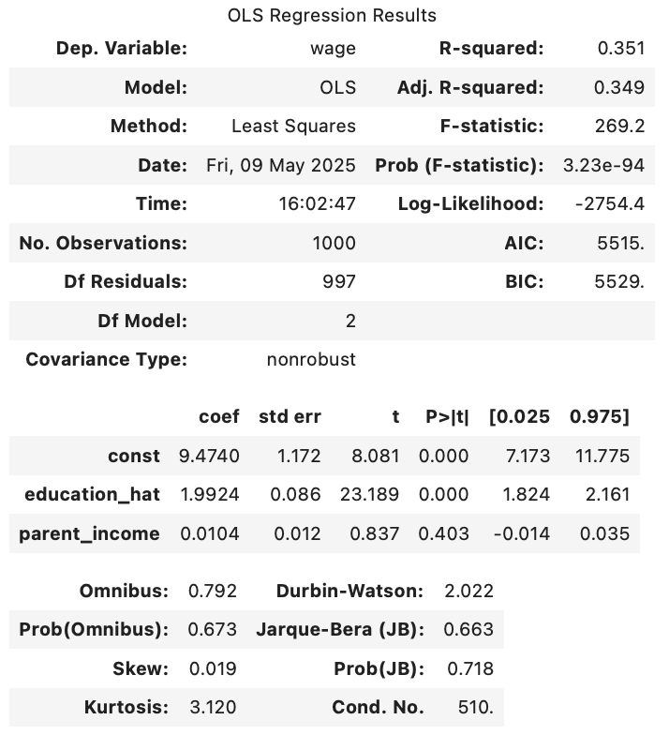
OLS vs 2SLS
OLS is seemingly biased upward, because education is correlated with unobserved ability, and overstated the impact of education, 2.2267 vs 1.9924, 12% overstated!

Slide 17
When to use these methods
RCT if possible!
Policy change over time + comparison group = DiD
Sharp cutoff rule = RDD
Omitted variable, reverse causality, or measurement error = IV/2SLS
Note: All these methods have in common: They try to isolate variation in X that is as-if random
We’re trying to mimic RCT!

Slide 18
Why causal inference is hard!
We never observe true counterfactual
We rely on assumptions we cannot fully test
Different methods can give different answers
Small violations can create large biases

Slide 19
